Slide 1
Lasers

Slide 2
Laser LASER "Light Amplification by Stimulated Emission of Radiation"

Slide 3
Characteristics
Monochromatic
Coherent
Highly Directional (Less Divergence)
High Brightness

Slide 4
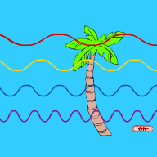

Characteristics – Monochoromatic
Ordinary Light
Monochromatic

Slide 5
Monochromatic
Laser light consists of essentially one wavelength, having its origin in stimulated emission from one set of atomic energy levels.
Monochromatic refers to a single wavelength, or “one color” of light.
Laser radiation contains a narrow band of wavelengths and can be produced closer to monochromatic than light from other sources.

Slide 6
Monochromatic
Monochromaticity refers to a pure spectral color of a single wavelength.
A beam is more and more monochromatic if the line spread in frequency is narrow or small.
This line width is an outcome of the homogeneous broadening factors and inhomogeneous broadening factors.
Despite these broadening mechanisms the line width in a laser is generally very small as compared to the normal lights.
The linewidth of laser is the width of laser beam frequency. Laser linewidth is much narrower than normal light.

Slide 7
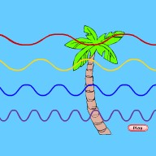

Characteristics - coherence
White Light
Coherent

Slide 8
Coherence
Laser beam is highly coherent, i.e, different parts of beam maintain
a phase relationship for a long time results in interference effect
Temporal Coherence (Δτ) : Time Δτ after which phase correlation between two waves which were initially in phase (or between two points in same wave which had a known phase difference) drops significantly
loss of coherence - optical source does not emit a continuous wave for all time to come
Thermal sources: Typical life time of Δt = 10⁻⁷ s so that a wave which seems continuous, actually consists of a sequence of waves which are typically cΔt ≈ 0.3 m long with no phase correlation between parts of one wave train and another

Slide 9
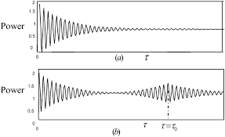

Slide 10
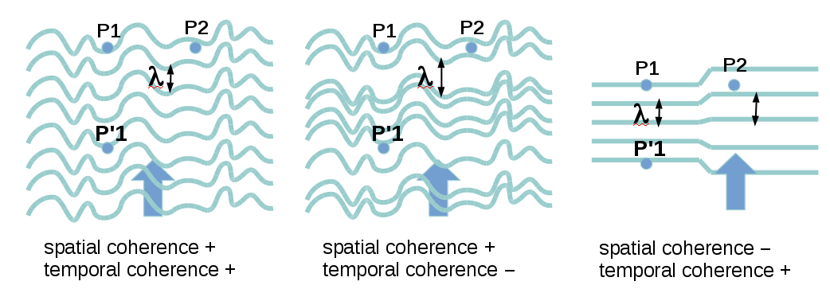

Slide 11
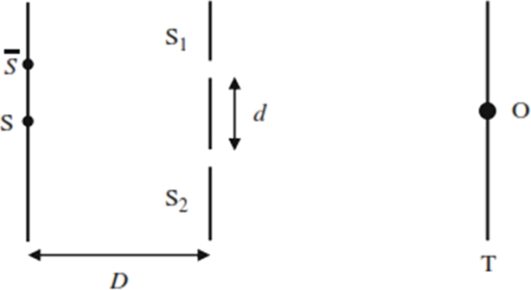
Spatial Coherence
Spatial coherence: Distance over which phase correlation exists between different points in same wave in a direction perpendicular to direction of observation

Slide 12
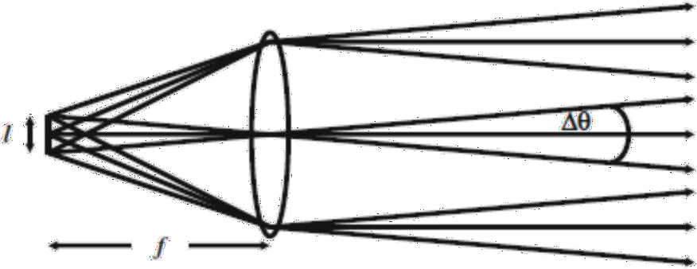
Characteristics – Directionality
Directionality – Less Divergence
less than 10^{–5} radians (∼ 2 s of arc) extremely small divergence
surveying, remote sensing, LIDAR, etc.
Divergence of laser beam is primarily due to diffraction
Most laser beams - spot size (radius of cross section of laser beam) of beam is about few millimeters
Divergence angle of beam: 𝜃 ≈ ^{λ0} , λ – free space wavelength
𝜋𝜔₀
0
ω₀ – spot size

Slide 13
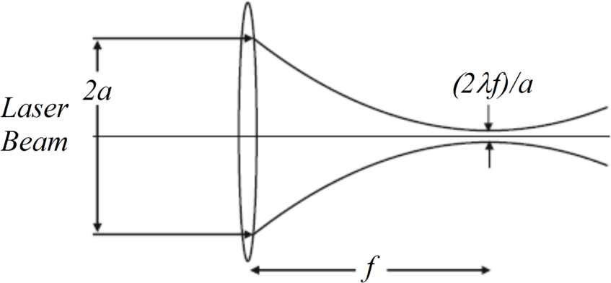
Characteristics – directionality
Spot size 1 mm and wavelength of 0.6 μm, divergence angle ∼ 0.01◦
Tight Focusing: focused to very small areas - few (μm)² -
determined by diffraction effects - Smaller λ - smaller spot size
surgery, material processing, compact discs
F – number = focal length / lens dia.; Camera smaller f – number better resolution
laser beam falls on convex lens - radius of focused spot ∝
wavelength and f-number, (laser beam fills entire lens area)

Slide 14
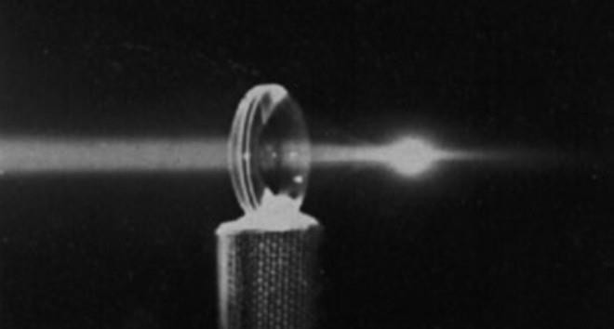
Characteristics – directionality
lens f-number - 2 (i.e., focal length twice lens diameter), then for a laser wavelength of 600 nm the radius of focused spot - 1.5 μm
Area of focused spot = 7 μm²
Power of 1 MW (= 10⁶ W), intensity at focused spot would be 14 TW/cm² light lead to electric fields of 10⁹ V/m – spark in air
very high electric fields inside medium, can change properties medium - non-linear effects

Slide 15
Characteristics – directionality
Low-power (≈ 2 mW) diffraction-limited laser beam incident on eye, focused to very small spot - intensity 100 W/cm² on retina – damage the retina
20 W bulb at 5 m from eye, produces bulb image on retina and produce intensity only 10 W/m² on retina - eye surgery and laser cutting
Directly looking at sun, power density in image 30 kW/m²
On earth, about 1.35 kW of solar energy is incident (normally) on 1 _{m}2
Energy entering eye is about 4 mW - sun subtends 0.5º on earth, radius of image of sun (on retina) is about 2 × 10^{–4} m
If we directly looking at sun power density in image formed is 30 kW/m²
Never look into sun; retina will be damaged not only because of high intensities but also because of large ultraviolet content

Slide 16

Characteristics – directionality
Directionality – Less Divergence
Relative
beam width
θ_{d}
₌ βλ
Beam Divergence: θ
d
D
β ∼ 1= f(type of amplitude distribution, definition of beam diameter)
λ = wavelength
D = Beam diameter

Slide 17
Characteristics – Brightness
The brightness of a light source is defined as the power emitted per unit surface area per unit solid angle.
For a laser beam of power P, with a circular beam cross section of diameter D and a divergence angle θ with the resultant emission solid angle πθ² , the brightness of laser beam is defined as:
B=4 P /(π D θ)²
The max brightness is reached when the beam is perfect spatial coherent.
B_{max}=4 P/(πλβ)²
In case of limited diffraction (θ_{d}= λβ/ D, D = λβ/ θ_{d} , θ_{d} = θ)

Slide 18

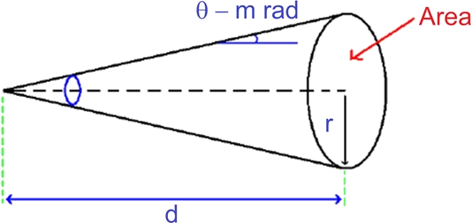
Characteristics – Brightness
Brightness of Sun
Surface temperature ∼ 6000 K
Stefan’s Law ρ = σT⁴ = 5.6696 × 10⁻⁸ × 6000⁴
_{Energy density} = 7.4 × 10⁷ Watt / m²
∴Brightness = ρ/4π = 5.9 × 10⁶ Watt / m² / Sr
Brightness of He-Ne Laser (632.8 nm, 1 mW, spot size 1 mm, θ_{d} 0.5 m. rad)
_{d} 2
Ω = πθ ² = 7.85 ×10⁻⁷ Sr
Solid angle Ω = ^{Area} , r = d × θ
1 mW
Power density =
= 1273 W/m ²
π(5 ×10⁻⁴ )²
1273
7.85 ×10⁻⁷
Brightness =
= 1.62 ×10⁹ W/m ² /Sr
∴Brightness of laser ∼ 300 times of Sun

Slide 19
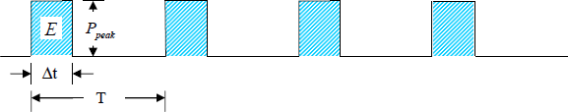
Laser Output
Continuous Output (CW) | Pulsed Output (P)
Time | Energy (Joules)
Power (Watts)
₌ E
P
peak
Δt
P = ^{E} = Ef
avg
T
Fluence = Energy per unit area (J/cm²)

Slide 20
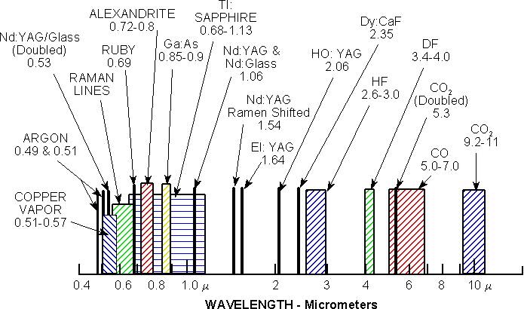
Laser wavelengths

Slide 21
Types of Lasers

Slide 22
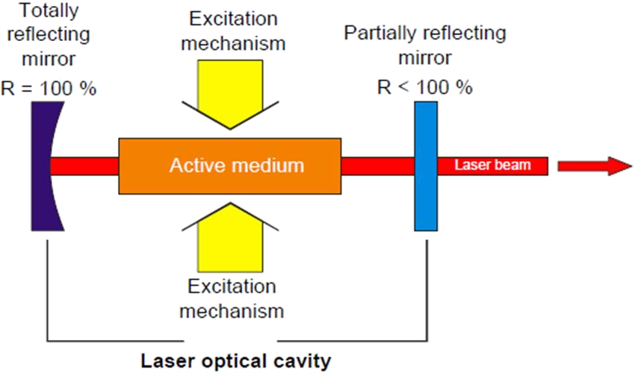
Laser System

Slide 23
Types
Solid State lasers – Ruby laser, Nd:YAG (1.06 μm), Ho:YAG (2.09 μm), Er:YAG (2.94 μm), DPSS-Yb (1.03 μm)
Gas lasers - CO₂ (10.6 μm), ArF (193 nm), KrF (248 nm), XeCl (310 nm)
Liquid lasers – Organic dyes – wavelength tunability (IR to UV)

Slide 24
Ruby Laser
First laser operated successfully - Ruby laser – Maiman 1960
Lasing medium – Ruby rod (length: 2 – 20 cm, dia: 0.1 – 2 cm) - matrix of aluminum oxide in which some of aluminum ions replaced by chromium ions (~0.05% by weight)
3 – level laser. Lasing action - energy levels of chromium ions
pumping of chromium ions - flash lamp (Input energy 10 – 20 KJ) (e.g., a xenon or krypton flash lamp)
Chromium ions in ground state absorb radiation around wavelengths of 5500 Å and 4000 Å and excited to the levels marked E₁ and E₂

Slide 25
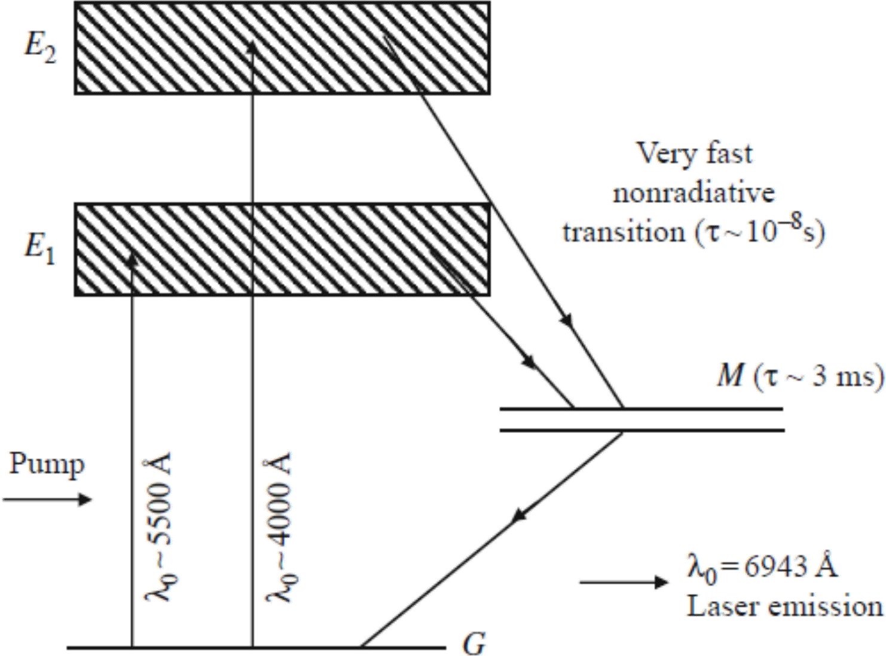
Ruby Laser

Slide 26
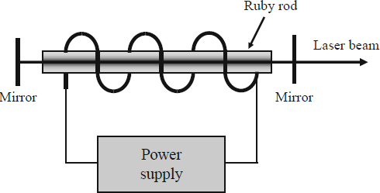
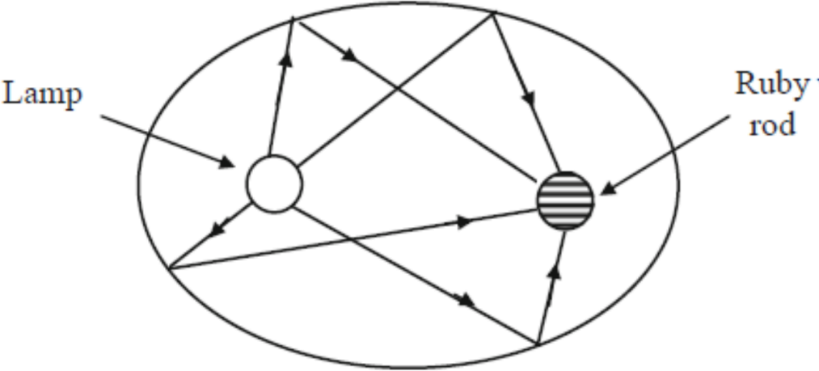
Ruby Laser
Flash lamp operation leads pulsed output
Flash lamp OFF: population of upper level is depleted very rapidly and lasing stops arrival of next flash
Output is highly irregular function of time with intensity having random amplitude fluctuations of varying duration – laser spiking

Slide 27
Neodymium-Based Lasers
Nd:YAG laser (YAG stands for yttrium aluminum garnet - Y₃Al₅O₁₂) and Nd:glass – 4 level laser
Energy levels of neodymium ion take part in laser emission
Nd ions in YAG or glass host has specific advantages and applications
Since glass - amorphous structure - fluorescent linewidth of emission is very large leads high laser threshold
YAG - crystalline - linewidth is much smaller - much lower thresholds for laser oscillation
Linewidth of glass host is much larger - production of ultrashort pulses using mode locking (τ = 1/Δλ) and for Q-switching
Excellent optical quality and excellent uniformity of doping

Slide 28
Neodymium-Based Lasers
For continuous or very high pulse repetition rate operation, Nd:YAG laser preferred
For high energy-pulsed operation, Nd:glass lasers may be preferred
Nd:YAG Laser (1.06 μm):
Energy difference between lower laser level and ground level is
∼ 0.26 eV, ratio of its population to that of ground state at room temperature (T = 300 K) is e^{−ΔE}/k_{B}T ≈ e⁻⁹ << 1
Thus lower laser level is almost unpopulated
Lower laser level is almost unpopulated and population inversion is
easy to achieve
Nd ions pump bands for excitation - 0.81 and 0.75 μm regions pumping using arc lamps (e.g., the Krypton arc lamp)

Slide 29
Neodymium-Based Lasers
Typical neodymium ion concentrations used are ∼1.38 × 10²⁰ cm^{–3}
Spontaneous lifetime corresponding to laser transition is 550 μs and emission line corresponds to homogeneous broadening and has width Δν ∼ 1.2×10¹¹ Hz which corresponds to Δλ ∼ 4.5 Å.
We have shown in Section 5.4 that Nd:YAG laser has much lower threshold of oscillation than ruby laser
Efficient pumping of Nd ions to ULL can be accomplished using
laser diodes – less heat generation - compact Nd-based lasers
Intracavity 2nd harmonic generator efficiently convert 1060 to 532 nm
₍₂nd
harmonic of 1064 nm of Nd:YAG) leading to efficient green
lasers

Slide 30
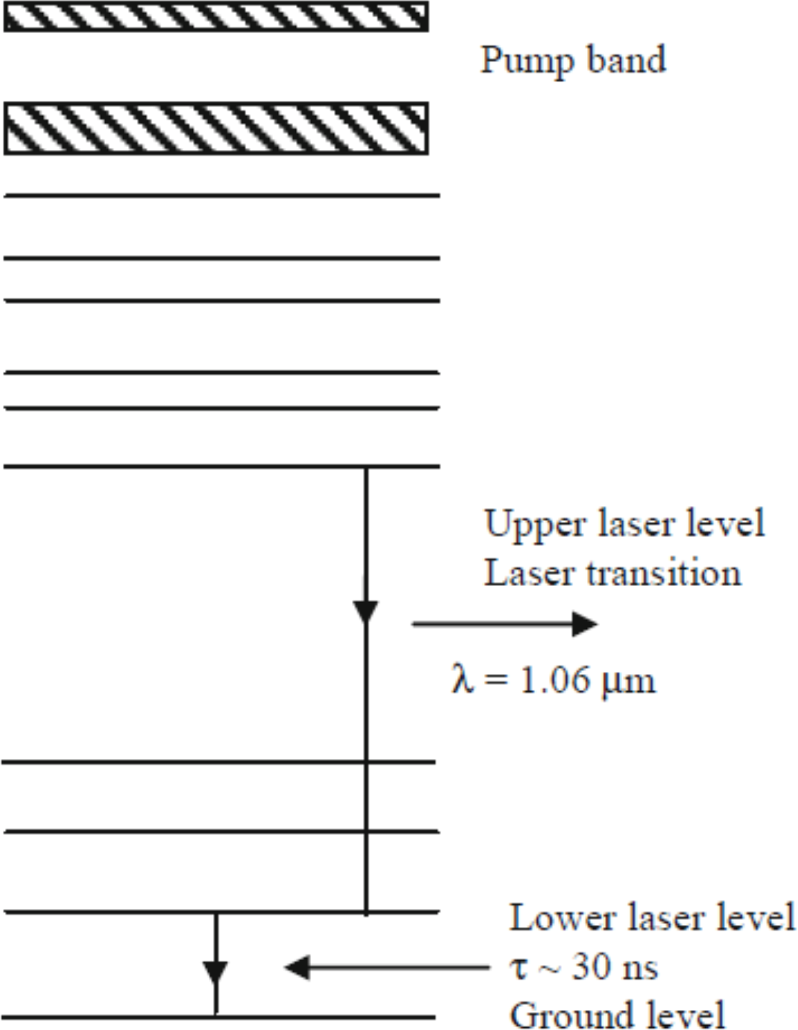
Neodymium-Based Lasers
Applications - range finders, illuminators with Q –switched operation giving about 10 – 50 pulses per second with output energies in the range of 100 mJ per pulse, and pulse width ∼ 10 ns
resistor trimming, scribing, micromachining operations, welding, hole drilling, etc.

Slide 31
Neodymium-Based Lasers
Nd:Glass Laser (1.06 μm):
Nd ion concentrations are ∼2.8 × 10²⁰ cm^{–3} and various silicate and phosphate glasses are used as host material
Glass has amorphous structure - different neodymium ions situated at different sites have slightly different surroundings - inhomogeneous broadening resultant linewidth Δv ∼ 7.5 × 1012 Hz which corresponds to Δλ ∼ 260 Å larger than Nd:YAG laser
Consequently the threshold pump power is higher
Nd:glass lasers suitable for high energy-pulsed operation laser fusion where requirement of sub-nanosecond pulses with an energy content of several kilojoules (i.e., peak powers of several tens of terawatts)

Slide 32
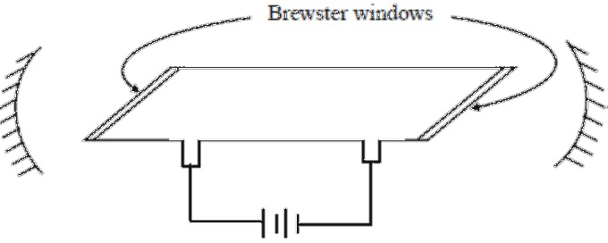
He-Ne Laser – first gas laser
Atoms characterized by sharp energy levels as compared to solids - electrical discharge to pump atoms
Long and narrow discharge tube (diameter ~ 2 – 8 mm and length 10–100 cm) filled with helium (1 torr) and neon (0.1 torr)
Lasing atoms are neon atoms and helium for selective pumping of
upper laser level

Slide 33
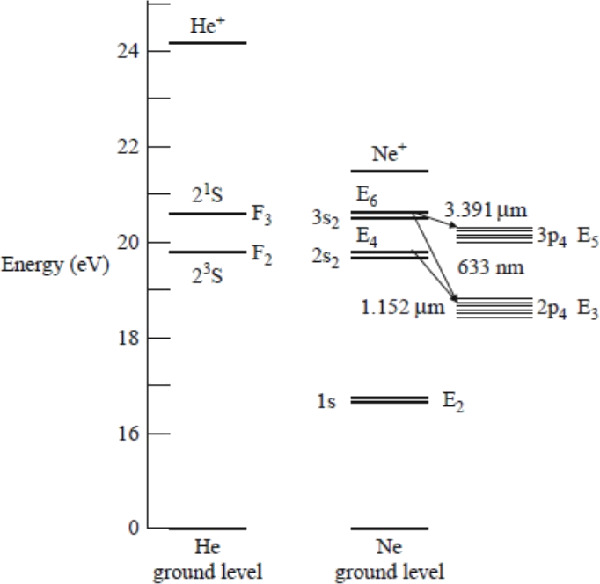
He-Ne Laser – First gas laser

Slide 34
He-Ne Laser – First gas laser
Electrical discharge in gas - electrons which are accelerated collide with helium and neon atoms and excite them to higher energy levels
Helium atoms tend to accumulate at levels F₂ and F₃ due to their long lifetimes of ∼ 10^{–4} and 5 × 10^{–6} s, respectively
Since levels E₄ and E of neon atoms have almost same energy as F₂ and F₃, excited helium atoms colliding with neon atoms in ground state can excite neon atoms to E₄ and E₆
Since pressure of helium is ten times that of neon, E₄ and E₆ of neon are selectively populated as compared to other levels of neon

Slide 35
He-Ne Laser – First gas laser
Transition between E₆ and E₃ produces popular 6328 Å line
Neon atoms de-excite through spontaneous emission from E₃ to E₂
(lifetime ∼ 10^{–8} s)
Since this time is shorter than lifetime of level E₆ (∼ 10^{–7} s) -achieve steady-state Population Inversion between E₆ and E₃
Level E₂ is metastable and thus tends to collect atoms
Atoms from this level relax back to ground level mainly through collisions with walls of tube
Since E₂ is metastable it is possible for atoms in this level to absorb spontaneously emitted radiation in E₃ → E₂ transition to be re-excited to E₃
This will have effect of reducing inversion. It is for this reason that gain transition is found to increase with decreasing tube diameter
Other two important wavelengths 1.15 and 3.39 μm, correspond to E₄→E₃ and E₆→E₅ transitions

Slide 36
He-Ne Laser – First gas laser
Both 3.39 μm and 6328 Å transitions - same upper laser level
Laser can be made to oscillate at 6328 Å by either using optical elements in path which strongly absorb 3.39 μm wavelength or increasing linewidth through Zeeman effect by applying an inhomogeneous magnetic field across tube
If resonator mirrors are placed outside discharge tube then reflections from ends of discharge tube can be avoided by placing windows at Brewster angle
In such a case beam polarized in plane of incidence suffers no reflection at windows while perpendicular polarization suffers reflection losses leads to polarized output of laser

Slide 37
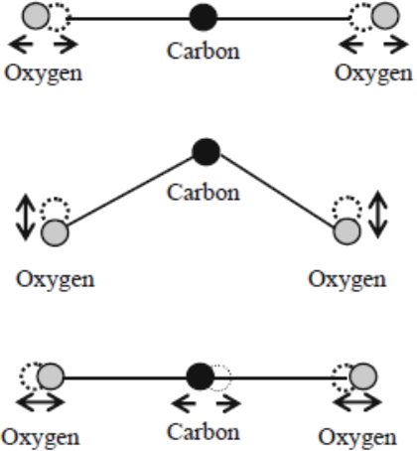
CO₂ Laser
Transitions occurring between different vibrational states of CO₂ molecule
CO₂ molecule - central carbon atom with two oxygen atoms attached one on either side - three independent modes of vibration

Slide 38

CO₂ Laser
Symmetric stretch, bending, and asymmetric stretch modes - characterized by definite frequency of vibration
Vibrational degrees of freedom are quantized, i.e., when a molecule vibrates in any of the modes it can have only discrete set of energies
ν1 - frequency corresponding to -symmetric stretch mode then -
molecule can have energies of only:

Slide 39
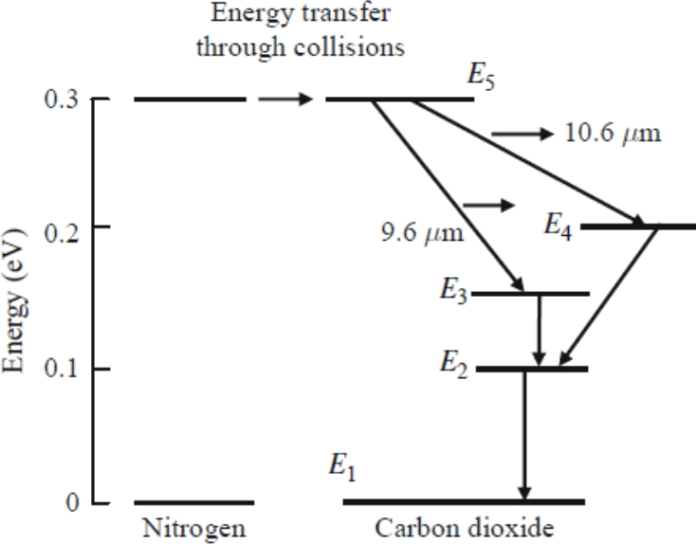
CO₂ Laser

Slide 40
CO₂ Laser
Laser transition at 10.6 μm occurs between (001) and (100) levels of CO₂
Excitation of carbon dioxide molecules to long-lived level (001) occurs both through collisional transfer from nearly resonant excited nitrogen molecules and also from cascading down of carbon dioxide molecules from higher energy levels
Efficient pumping to (001) level and also because all energy levels involved are close to ground level
Atomic quantum efficiency - ratio of energy difference corresponding to laser transition to energy difference of pump transition

Slide 41
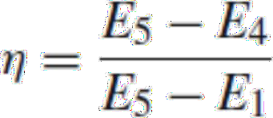
CO₂ Laser
η is high (∼ 45%) - a large portion of input power into useful laser power
Output powers of several watts to several kilowatts obtained from CO2 lasers
•
High-power CO2 lasers: Materials processing, welding, hole drilling, cutting, etc.,
Atmospheric attenuation at 10.6 μm is low open air communications

Slide 42
Applications

Slide 43
Laser Material Interaction
Medicine
Bloodless surgery, laser healing, laser therapy,
kidney stone treatment, eye surgery, dentistry
Cutting, welding, micro and nano machining, heat treatment of materials, marking parts
Marking targets, missile guiding, electro-optical counter measures
Spectroscopy, laser ablation, laser annealing, laser scattering, laser interferometer
Laser printers, CDs, barcode scanners, laser pointers, holograms
Industry
Defense
Research
Commercial

Slide 44
Laser Material Interaction
Laser interaction – absorption, reflection, scattering, transmission
Heating, melting, vaporization, plasma formation – laser parameters (wavelength and fluence), material properties (absorption and thermal properties)
Ablation mechanisms – Photothermal, photomechanical, and/or photochemical

Slide 45
Interaction Mechanisms
Photothermal
Radiation energy
energy
is converted into lattice vibrational
Thermal relaxation time – much shorter than desorption time – ablation through thermal process
Dominating processes - melting, vaporization and plasma formation.
Photomechanical
Mechanical stress in the material due to laser irradiation

Slide 46
Interaction Mechanisms
Photochemical
Polymers processed with UV laser radiation.
Bond energies in organic molecular solids (O=H [4.8 eV], N=H [4.1 eV], C-O [3.6 eV], C-C [3.6 eV], C=N [3 eV]) - Photon energies of common UV lasers (ArF [6.4 eV], KrF [5 eV], XeCl [4 eV]).
Photons break chemical bonds in molecules of organic materials - ablation

Slide 47
Medicine
Dermatology: removing tattoos, scars, stretch marks, sunspots, wrinkles, birthmarks, and hairs,
Dental procedures: caries removal,
Procedures, tooth whitening, and oral surgery,
Endoscopies,
Eye Surgery,
"No-Touch" removal of tumors, especially of brain and spinal cord,
Angioplasty and mechanisms of laser revascularization,
laparoscopic interventions,
Acupuncture,

Slide 48
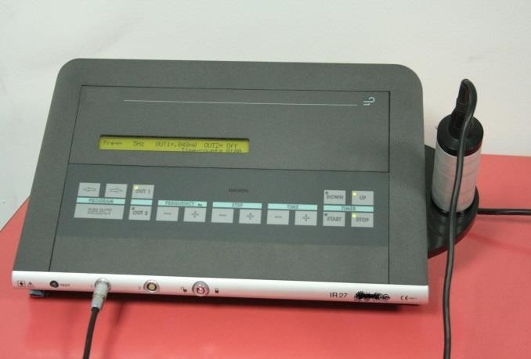
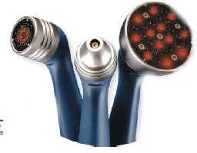
Medicine
Low Level Laser Therapy (LLLT), 10mW - 200mW
Low Intensity Laser Therapy (LILT).
Generation of heat
Initiate chemical change,
Disrupt molecular bonds and
Produce free radicals
Energy Density J/cm²
output power (Watts)
irradiation area (cm²)
time (seconds)

Slide 49
Medicine
Increased cell metabolism
Altered cell motility, cell membrane potentials, cell potentials
Increased cellular metabolism,
Improved localized blood circulation
Relief from acute and chronic pain
Reduced localized inflammation
Stimulation for wound healing and tissue repair
Stimulation of nerve function
Activation and proliferation of fibroblasts,

Slide 50
Biostimulation
Energy from laser radiation - stimulate biological function of cells, tissue, and systems and even raise overall vital energy
Stimulate regeneration of bone, blood, the lining of blood vessels, cartilage, nerve, and muscle
“Bio” stimulation = Life stimulation!

Slide 51
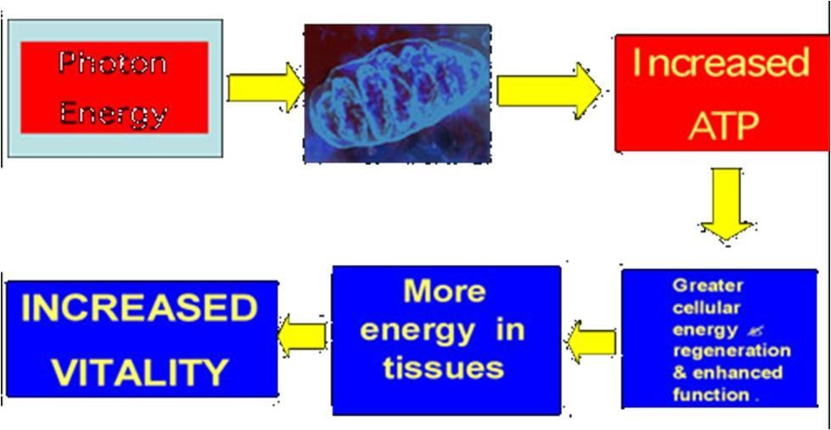
Biostimulation
Laser therapy adds energy through photon absorption by mitochondria
Mitochondria absorb laser radiation - activates a series of reactions to increase and store more cellular energy in the form of adenosine triphosphate (ATP)

Slide 52
Communication
Morse telegraph - 1860‘s, Transmission rate: ∼1bit/s
Distance: Due to application of relay stations: 1000 km
Invention of telephone 1876.
First coaxial cable system 1940 with capability to transmit 300 voice channels.
First microwave system was put into service in 1948 with a carrier frequency of 4GHz. - 100Mbit/s.
High speed coaxial systems need repeater spacing
∼1km.

Slide 53
Laser - Problems
Find the ratio of the probability of spontaneous emission to stimulated emission at 300 K for
(a) microwave photons of frequency ν = 10¹³ Hz. and = 3.35
(b) optical photons ν = 10¹⁵Hz. = 434.05
R = SPE/STE =
A system of atoms in thermal equilibrium is emitting and absorbing photons with energy of 2 eV. Determine the ratio of the transition rates of stimulated emission to spontaneous emission at a temperature of 300 K. Discuss the implications of your answer.

Slide 54
Find the ratio of populations of two energy levels in a laser if the transition between them produces light of wavelength 6493Å,assuming the ambient temperature as 27℃

